Slide 1

CN4005 Lesson 2 : IT Technology innovations
Dr Fadi Safieddine
1

Slide 2
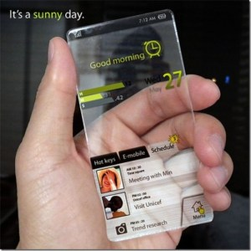
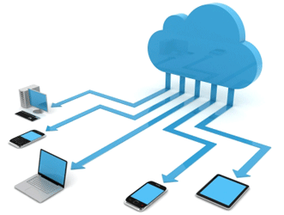

Lecture outline
Context of the lecture
The Assignment!
The Changing of Physiological Interaction
Increasing Portability and Mobility
The Digital Frontier
Cloud Computing
Artificial Intelligence
And More!

Slide 3

Context of the lecture
Your assignment has started!!
Task 3, 4, and 5 are going to be covered in this lesson and next.
Let us go through the assignment together!
What each task requires you to do?
Deadline for formative feedback.
This Photo by Unknown Author is licensed under CC BY

Slide 4
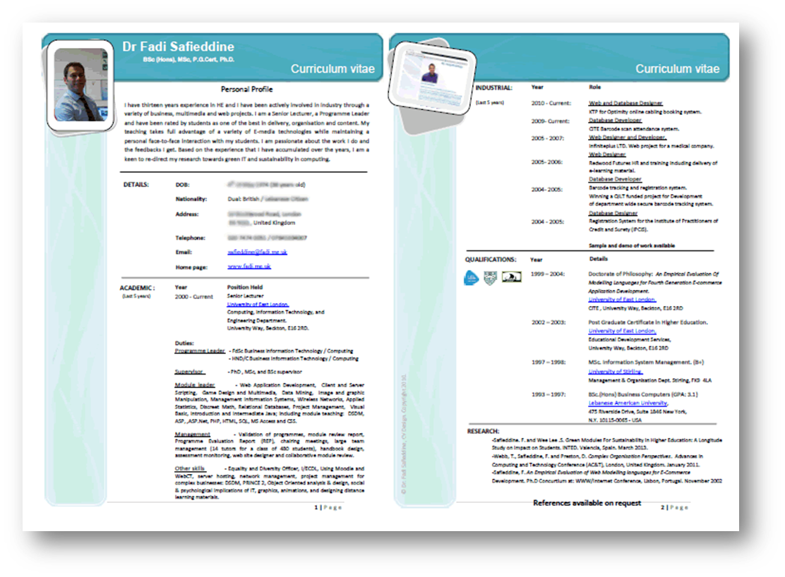
Task 1:
Task 1: Initial Self-assessment; Due week 2, L.O. 3. 10%. (Individual)
There are three tasks to complete:
Career Pathway has a 10% allocation of the grades and has to be completed via Moodle page. There is a form that needs to be completed after you watch a few short videos. The form and the instructions are found under the section called Career Pathway on the Moodle page.
Students also develop an initial CV based on any number of templates shown in the lecture and the lab—the initial CV to include current skills only.
Students are to provide email evidence that they contacted their personal Academic Advisor (ignore the video instructions about filling out the online form as the form has since expired).
Instructions on how to complete all these activities is found in lesson 1.

Slide 5
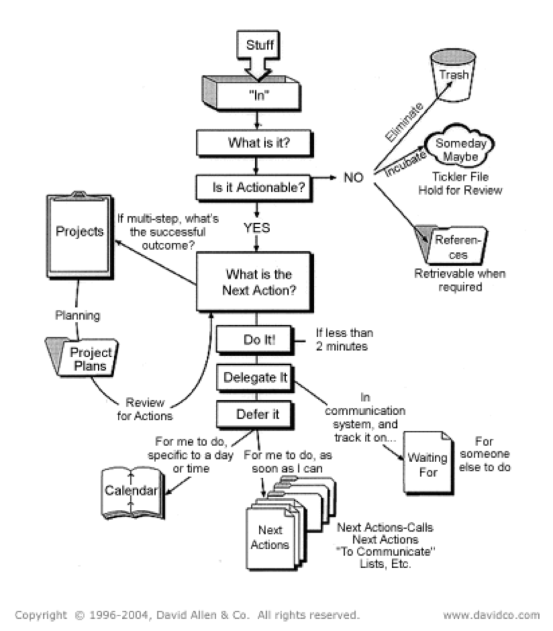
Task 2:
Task 2: Individual Time Management Plan; Due week 4, L.O. 1 & 5. 10% (Individual)
Students to create a comprehensive time management plan based on GTD. Students are allowed to use a different approach, provided it is an academically published approach, and they provide a citation of their source.
The key aspect of this assessment is that the student has demonstrated good forward planning that covers academic tasks and deadlines, personal development deadlines, and day to day deadlines.
Instructions on how to complete this task is found in lesson 4.

Slide 6

Task 3:
This Photo by Unknown Author is licensed under CC BY-SA
Task 3: Proposal for Pitch Idea; Due week 6, L.O.2, 3, & 6. 10% (Group)
Students to create short (no more than 500 words) proposal for innovative use of technology with business potential. Use this text to pitch and sell the idea. The themes we encourage are those that focus on reducing inequalities, improve sustainability, and environmental projects. To include a teamwork agreed format and role management.
Students should register their idea by the end of week 4. Two different groups of students cannot use the same concept for their project. Use lessons 1 and 2 for inspirations!

Slide 7
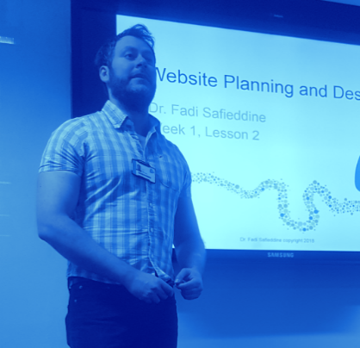
Task 4:
Task 4: Presentation skills and self-assessment; Due week 8, L.O. 3, 4, & 8. 30% (Group)
Students to demonstrate their presentation skills and submit the PowerPoint presentation along with a self-evaluation of their own skills. 20% of the grade will be based on the presentation, and 10% on the fairness of the self-evaluation report. Where students identify areas of improvement, the self-evaluation to reflect on how the team intends to address these in the future.
Instructions on how to complete this task is found in lessons 6 and 7

Slide 8
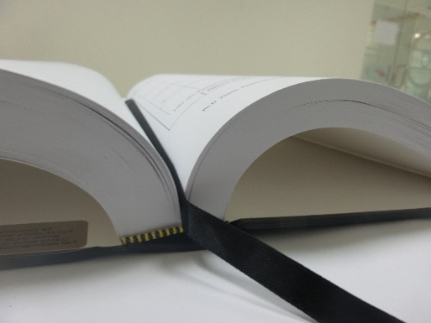
Task 5:
Task 5: IT Innovation Report; Due week 10, L.O. 4, 5, & 6. 30% (Group)
The proposal to be no more than 2000 words. The proposal will be assessed on how professional and complete it presents its ideas; correct citation and referencing of sources, structure, format, use of visual aids such as images, diagrams, and tables. Note students are allowed to modify and upgrade their ideas, but they should consult with the lab tutor to ensure their new proposal is unique.
Instructions on how to complete this task is found in lessons 8 and 9.

Slide 9
Task 6:
Task 6: Final Career Pathway and reflection on mental wellbeing; Due week 12, L.O. 3 & 5. 10% (Individual)
Career Pathway has a 10% allocation of the grades and has to be completed via this link. There is a form that needs to be completed after you watch a few short videos. The form and the instructions are found under the section called Career Pathway on the Moodle page.
Students to reflect on next term, what modules they will be learning, and what skills they aim to develop. Students to update the CV to reflect the new skills they have developed in this term.
Instructions on how to complete this task is found in lessons 1, 11, and 12.

Slide 10
End of Part 1
Activity 2.1. Who do you contact if you have any questions about:
How to do the assignment?
How to organise your groups?
How your assignment will be graded?

Slide 11
Innovation in IT
Part 2

Slide 12

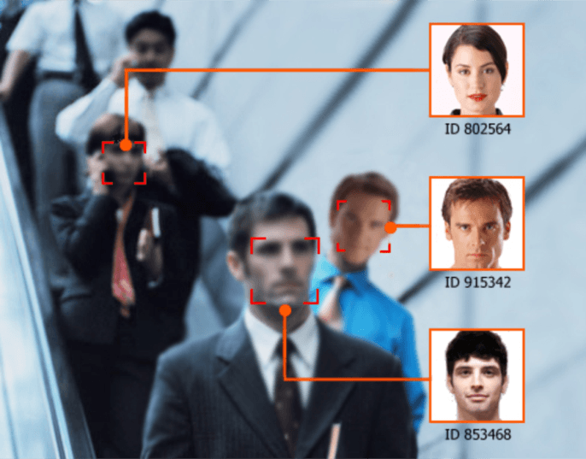
The Changing Of Physiological Interaction
Biometrics - the use of your physical characteristics to identify a person:
Fingerprint
Palm hand
Face-recognition
The blood vessels in the retina of your eye
The sound of a voice
Or even their breath!!

Slide 13
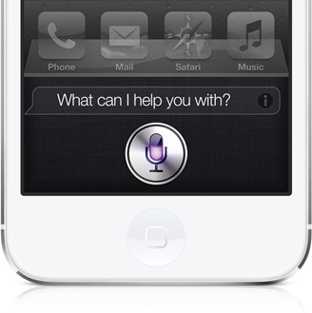
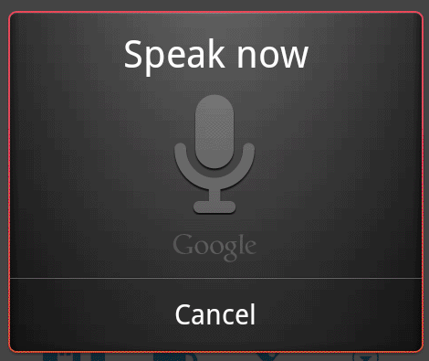
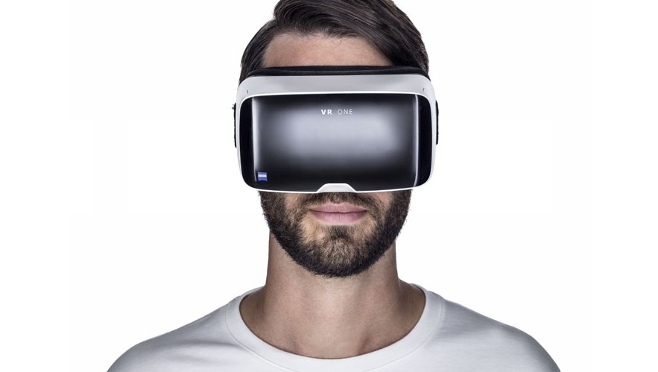
The Changing Of Physiological Interaction
Automatic Speech Recognition (ASR) – a system that not only captures spoken words but also distinguishes word groupings to form sentences.
Do you know examples of this?
Virtual Reality – a three-dimensional computer simulation in which you actively and physically participate.
Who has VR for their phone?

Slide 14
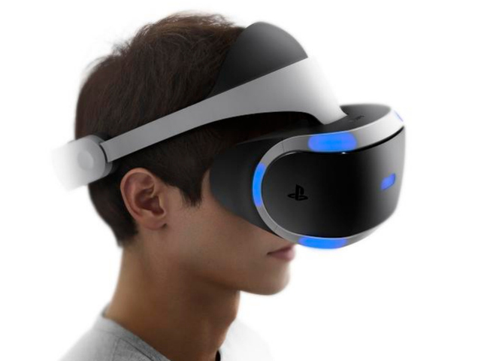
Virtual Reality
Goal of virtual reality (VR):
Create an environment in which users can interact and participate as they do in the real world
VR technology
Uses computer-generated, three-dimensional images to create the illusion of interaction in a real-world environment
VR terms:
Simulation
Interaction
Immersion
Telepresence
Full-body immersion
Networked communication

Slide 15
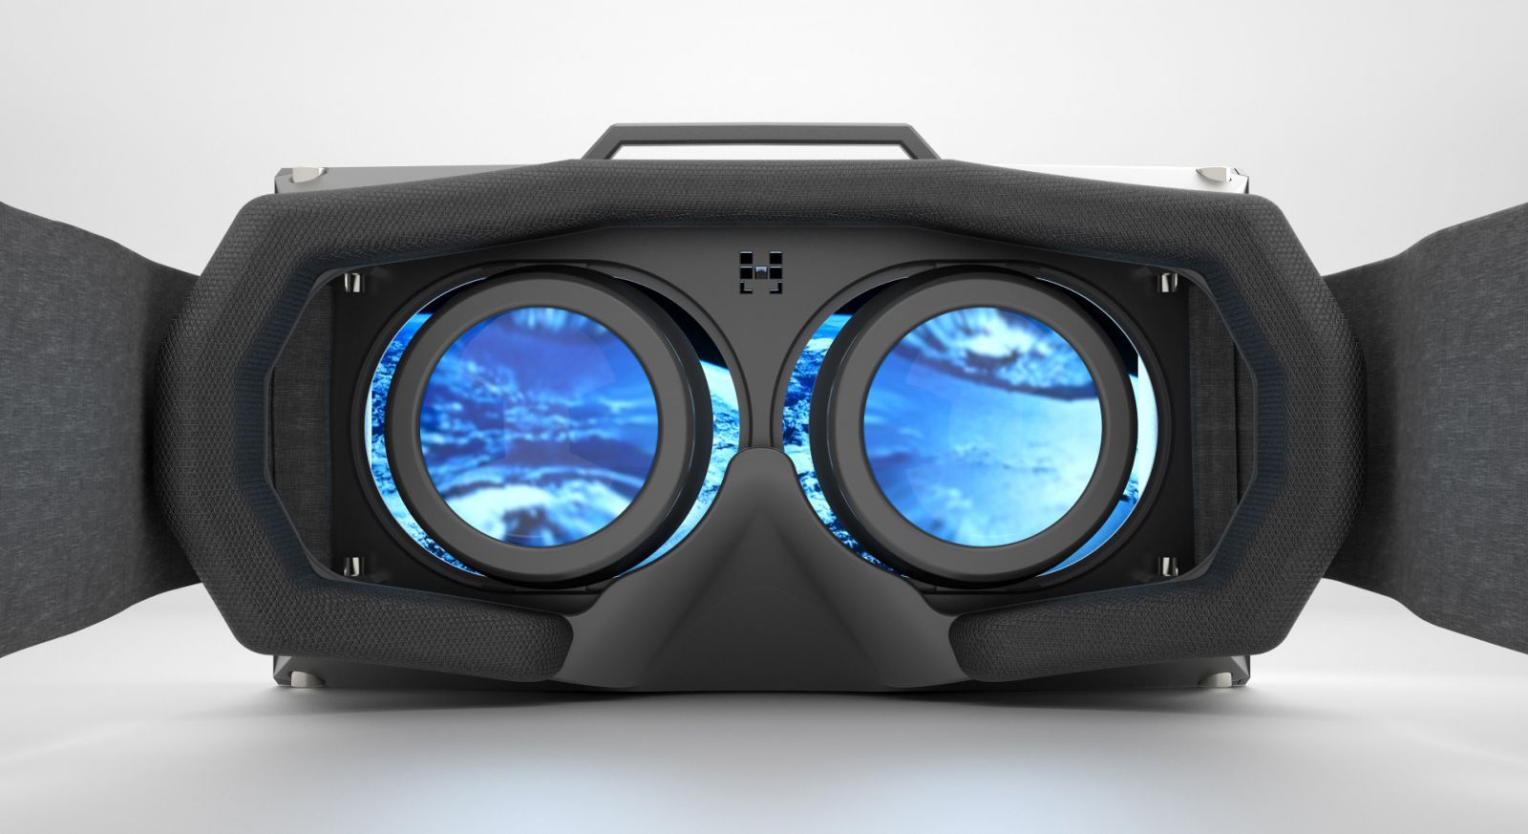
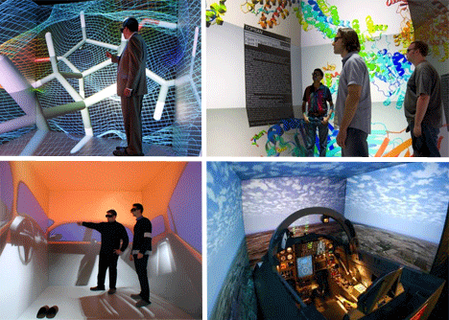
Types of Virtual Environments
Egocentric environment
User is totally immersed in the VR world
Most common technology used with this environment is a head-mounted display (HMD)
Exocentric environment
Data is still rendered in 3-D
Users can only view it onscreen
Main technology used in this environment is 3-D graphics
Notes:
In an egocentric environment, the user is totally immersed in the VR world. In an exocentric environment, the user is given a “ window view.” Data is still rendered in 3- D, but users can only view it on screen. They can’t interact with objects, as in an egocentric environment.
As you read through the following sections, you’ll want to be familiar with these terms:
• Simulation— Giving objects in a VR environment texture and shading for a 3- D appearance.
• Interaction— Enabling users to act on objects in a VR environment, as by using a data glove to pick up and move objects.
• Immersion— Giving users the feeling of being part of an environment by using special hardware and software ( such as a CAVE, discussed later in this section). The real world surrounding the VR envi-ronment is blocked out so that users can focus their attention on the virtual environment.
• Telepresence— Giving users the sense that they’re in another location ( even one geographically far away) and can manipulate objects as though they’re actually in that location. Telepresence systems use a variety of sophisticated hardware, discussed in “ Components of a Virtual Reality System.”
• Full- body immersion— Allowing users to move around freely by combining interactive environments with cameras, monitors, and other devices.
• Networked communication— Allowing users in different locations to interact and manipulate the same world at the same time by connecting two or more virtual worlds.

Slide 16
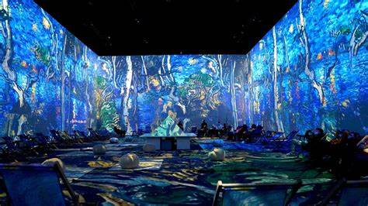
Museum Experiences

Slide 17

Museum Experiences
https://youtu.be/JNHoBreKagY?si=y4wtcM4FFms16Usn

Slide 18
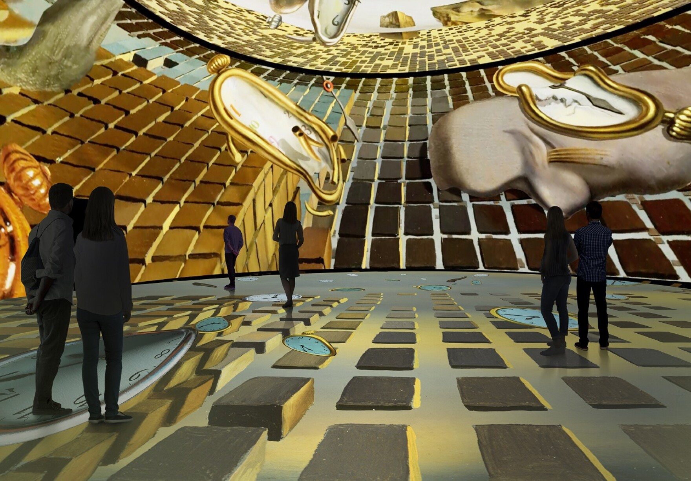
Museum Experiences

Slide 19
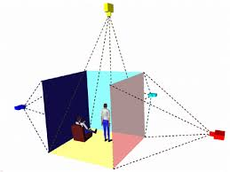
The Changing Of Physiological Interaction
CAVE (cave automatic virtual environment) –
a special 3-D virtual reality room that can display images of other people and objects located in other CAVEs all over the world.
Gives an all-around real experience of the environment.

Slide 20
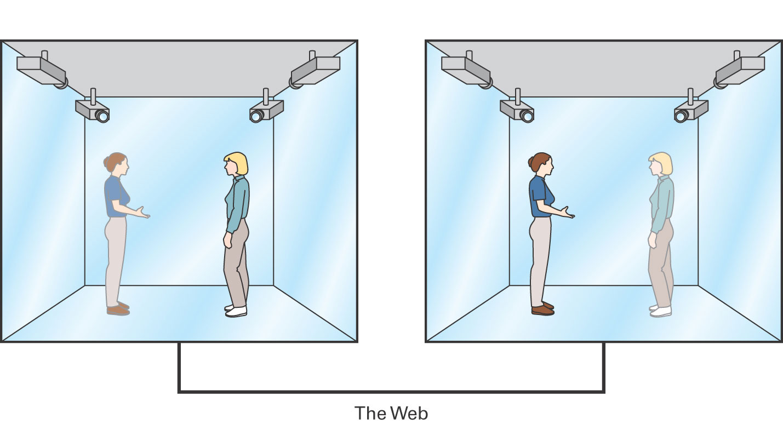
The Changing Of Physiological Interaction
Holographic devices – devices that create, capture, and/or display images in true three-dimensional form.

Slide 21
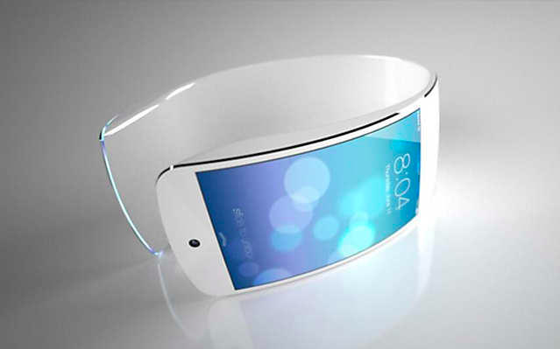
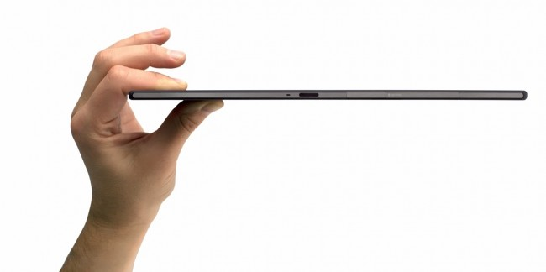
Increasing Portability and Mobility
Portability refers to how easy it is for you to carry around your technology.
Mobility encompasses what you have the ability to do with your technology while carrying it around.

Slide 22
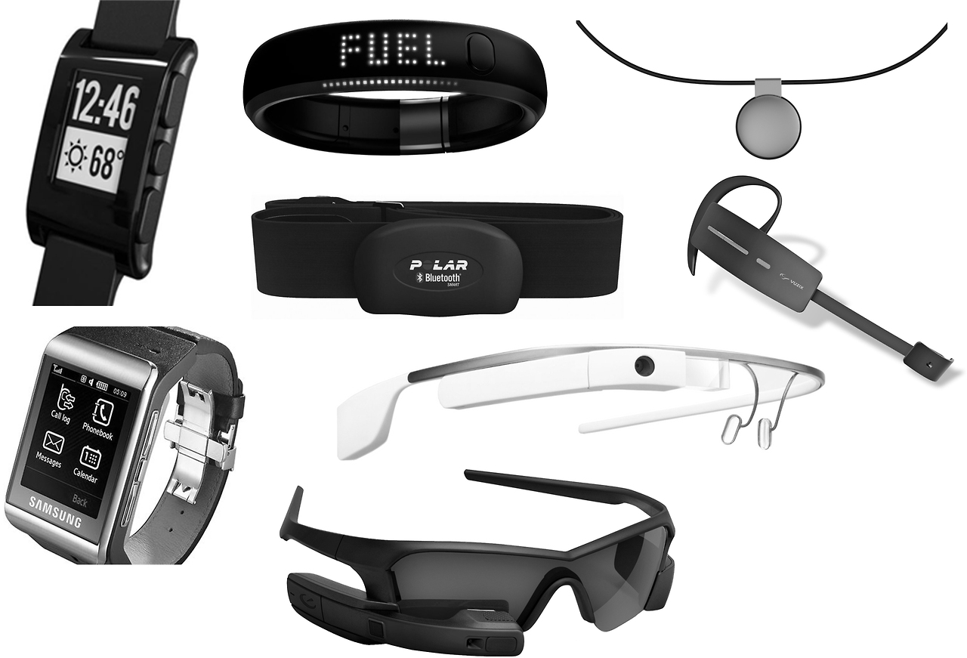
Increasing Portability and Mobility Wearable Computers
Wearable computer:
We tend to call them now “Wearable Technologies”
fully-equipped computer that you wear as a piece of clothing or attached to a piece of clothing similar to way you would carry your cell phone on your belt.
Give us examples of wearable technologies you know about?

Slide 23
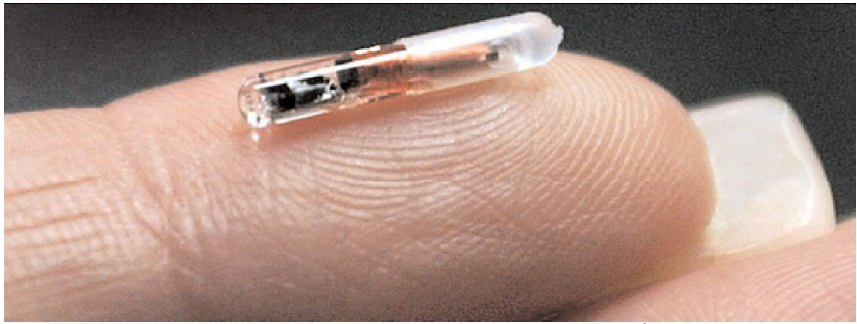
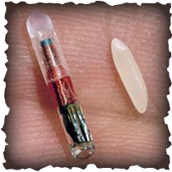
Increasing Portability and Mobility Implant Chips
Implant chip - a technology-enabled microchip implanted into the human body. Implant chips server two functions:
Contains memory which stores important information about you.
Many of these chips are GPS-enabled.
Global positioning system (GPS) - a collection of earth-orbiting satellites that transmit radio signals to determine longitude, latitude, speed, and direction of movement.
Used in your mobile phones
Cars

Slide 24
End of Part 2
Activity 2.2. Define the following technologies:
Biometric
Speech recognition
Virtual Reality
Cave
Holographic
Wearables
Implants

Slide 25
Innovation in IT
Part 3

Slide 26
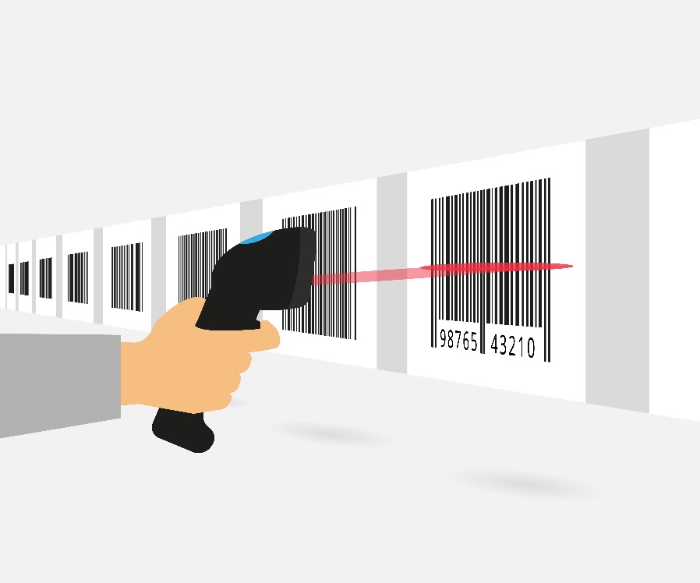
Introduction to Barcode Scanners:
Barcodes were created as a replacement for punch cards to identify product details
They have become very popular because of their simplicity and accuracy in the business community
Barcode identification systems are also critical elements in today’s global industry
These systems optically read a merchandises identification code and transmit this to a computer.
The computer then extracts the merchandise details from its database using the identification code.

Slide 27
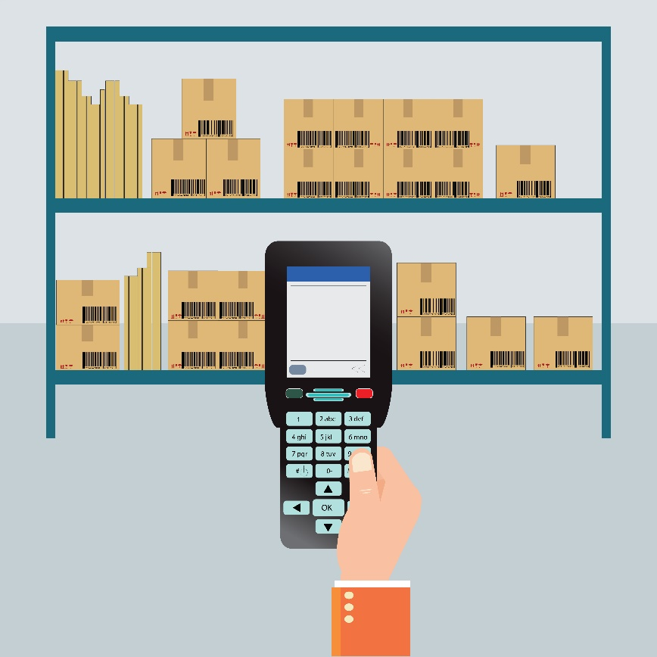
Introduction to Barcode Scanners:
Barcodes have two classifications:
one dimension and two dimensions
These classifications differ both in the way they represent data as well as how they decode the data
Some decode the data as letters only, some as numbers only, some combine letters and numbers, and some decode special character strings of various length and type
Barcode scanners work well if the barcode being scanned is flat, not wider than the scanner, and the symbols are not distorted.

Slide 28
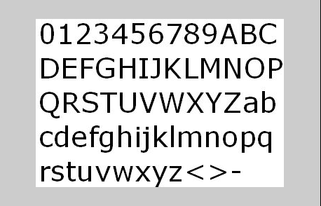
Predefined dictionary of characters

Slide 29
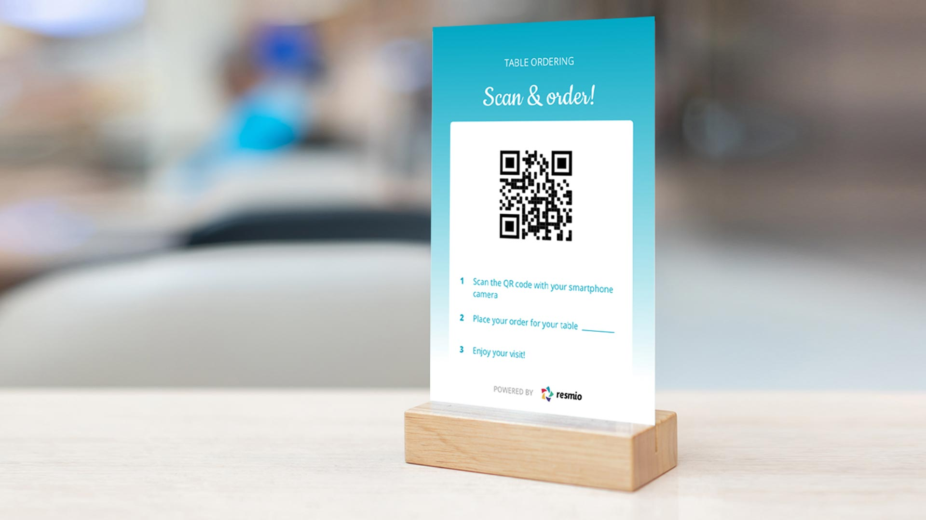

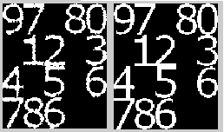

Slide 30
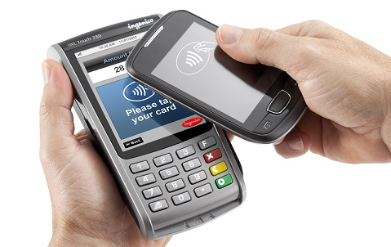
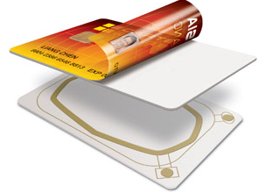
The Digital Frontier Digital Cash
NFC vs. RFID:
NFC (Near Field Communication)
is a short-range wireless connectivity standard
uses magnetic field induction to enable communication between devices
need to touch together or brought within a few centimeters of each other.
RFID (Radio Frequency Identification):
is a technology that incorporates the use radio frequency (RF) to uniquely identify an object, animal, or person.

Slide 31
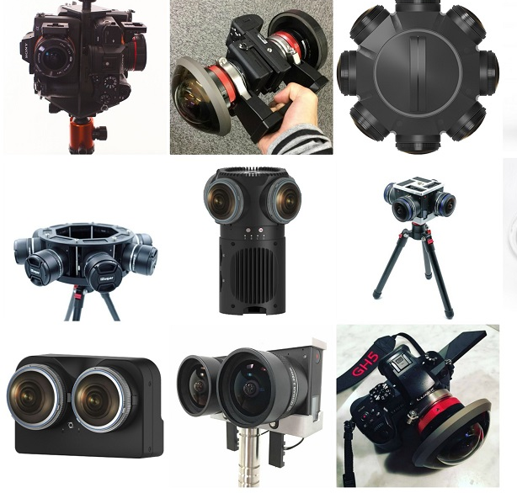
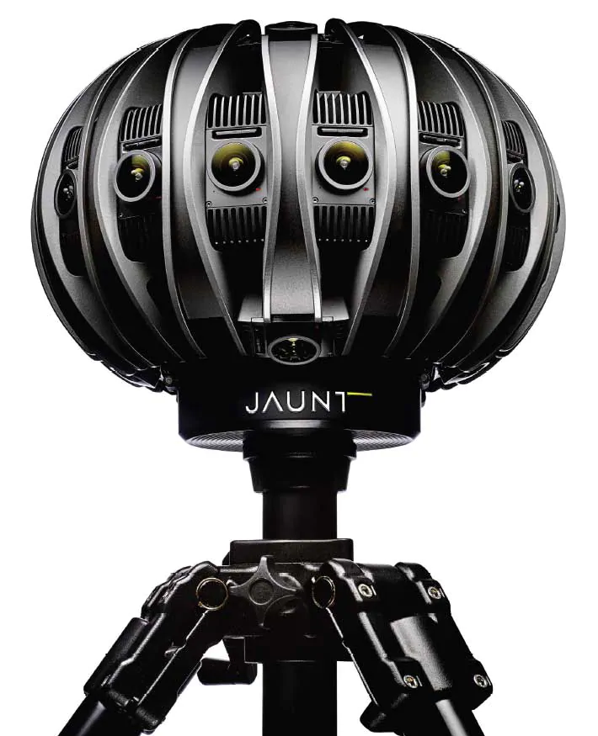
360 Cameras
In photography, an omnidirectional camera, also known as 360-degree camera, is a camera having a field of view that covers approximately the entire sphere or at least a full circle in the horizontal plane.
This used to be expensive to buy, but it is becoming more affordable.

Slide 32
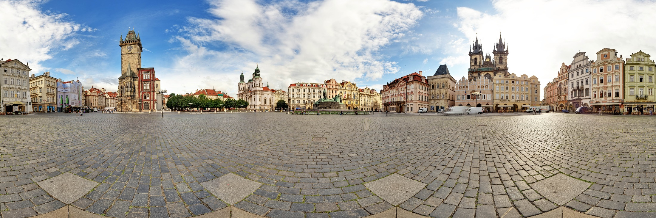
360 Cameras

Slide 33
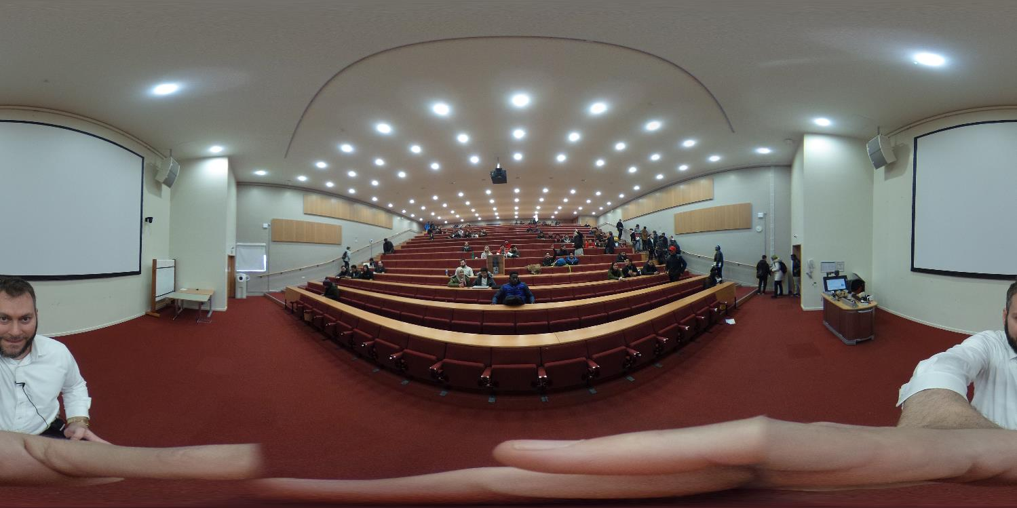
360 Cameras

Slide 34
End of Part 3
Activity 2.3. Define the following technologies:
Barcodes
NFC
RFID
360 Camera

Slide 35
Innovation in IT
Part 4

Slide 36
Cloud Computing:
What is cloud computing?
“…is a technology model in which any and all resources-application software, processing power, data storage, backup facilities, development tools… literary everything- are delivered as set of services via the Internet.” (p. 203)
The principle is simple:
Rather than buy expensive hardware and software for the running of your business, you rent it as a service!
However, you access your software and hardware processing services via the internet.

Slide 37
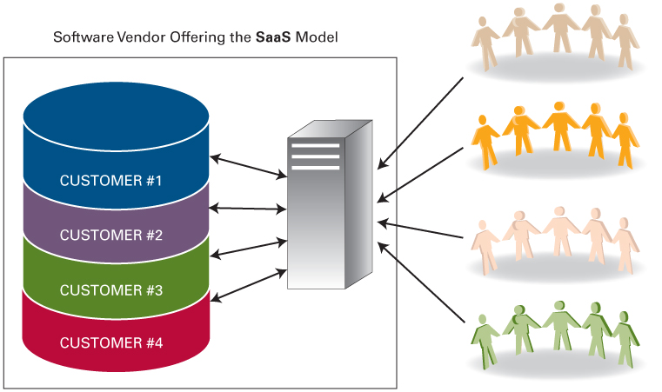
Cloud Computing:
What is on offer:
Software-as-a-Service (SaaS): Paying for software as ‘pay-per-use’ service rather than paying for the software outright.
It could be Accounting software, HR software, Engineering Software, or any application.
Used in the same concept we all use Software Centre at UEL
Only download software you need.
Notes:
Multi-tenancy: explaining here the concept that in effect all the users are ‘tenants’ of this software. While we can use it we should not (could not) change what it does or how it does it. For instance, we cannot change what Facebook does or remove the ‘timeline’ from your profile. SaaS: allows some customization of forms, data entry (what goes in), but nothing beyond that.

Slide 39
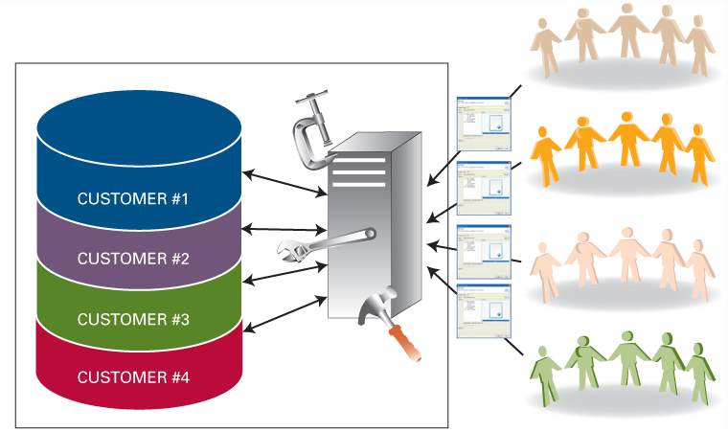
Cloud Computing:
What is on offer:
Platform-as-a-Service (PaaS):
Goes beyond (SaaS) allowing users to modify displays, how reports are generated, processing by using the application tools and adding/changing modules.
So while SaaS may have lots of ‘pre-built’ features, PaaS allows users to modify these features and create their own.
Access are available to re-program, test, and run customized displays.
Notes:
Moodle as an open source software can be used by Cloud based services to allow individual educational institutions who cannot afford to run it internally. But these organization could change design, logo, even the layout of this application to be custom to the needs for that organization. Even could change the way grades are calculated and how they are presented. Specialist modules can be added to allow say media processing, mathematic exams, or anything specialist at an additional fee.

Slide 40
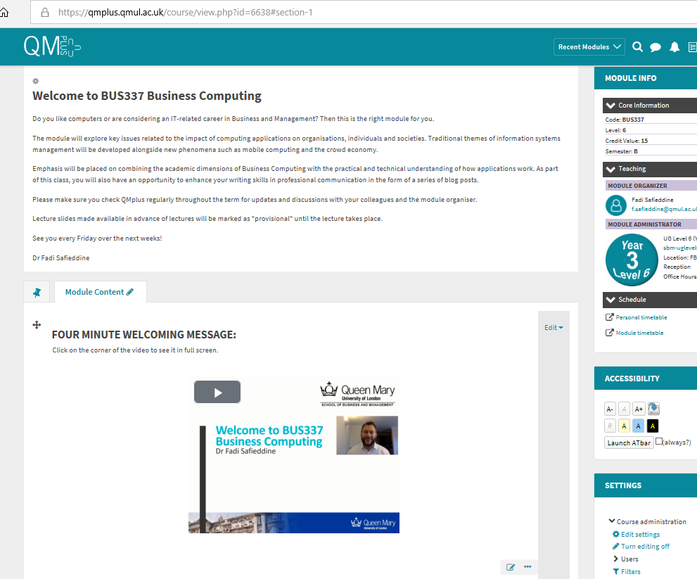
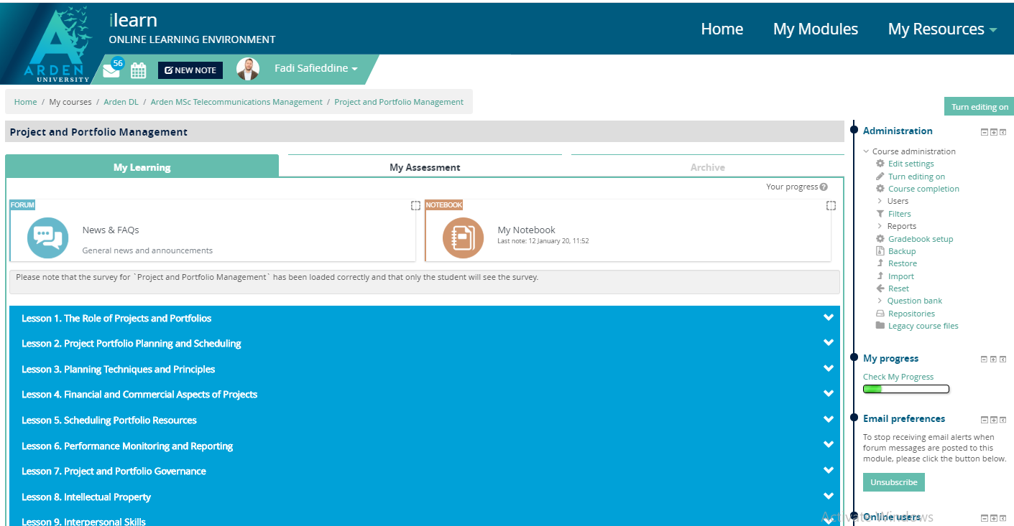
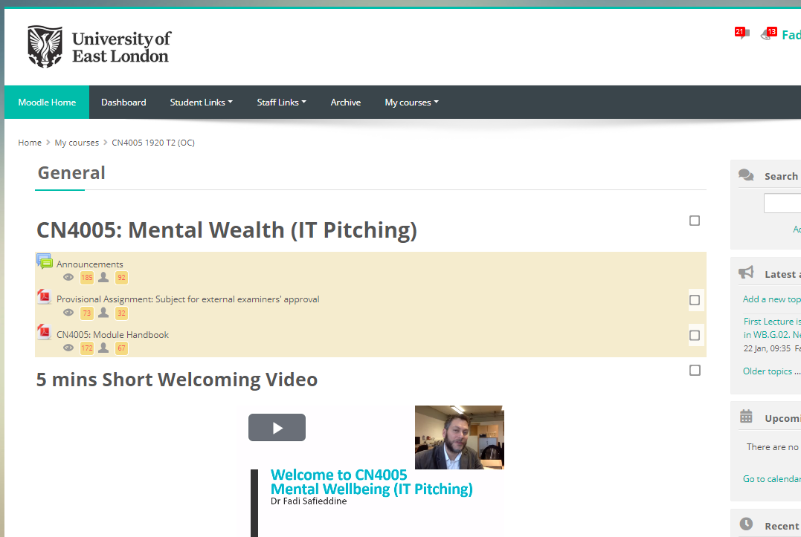
Drop box as PaaS: Where universities rent Moodle and modify as they need fit.
Notes:
Keep in mind the in its basic form, Moodle is free open source application.

Slide 41
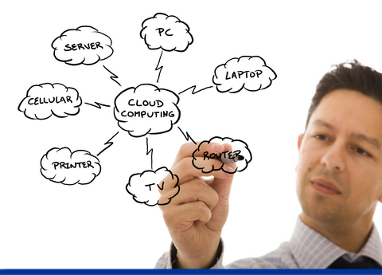
Cloud Computing:
What is on offer:
Infrastructure-As-A-Service (IaaS)
We rent the software, what about the hardware?
We are not speaking about ‘physical’ hardware, we still need Computers, printers, and modem for the internet.
What can you rent in IAAS:
Extensive Storage that can be accessed from anywhere.
Network equipment
Operating Systems.
Backups
Processing power
Anti-virus and protection software/hardware.
Notes:
What it means to be an organization completely dependent on Cloud Computing?
1- No longer need to network computers or buy a server – they need to be connect to the Internet.
2- No longer need to save anything locally, everything is stored on cloud and shared with your closed group of staff.
3- No longer need network operating system (which tend to be more expensive)
4- No longer need to back up, this is done automatically by the Cloud and you can specify how often they do it.
5- No longer need to by the latest computer equipment to process large and expensive applications.
6- The price of protecting the system is cut down significantly.

Slide 42
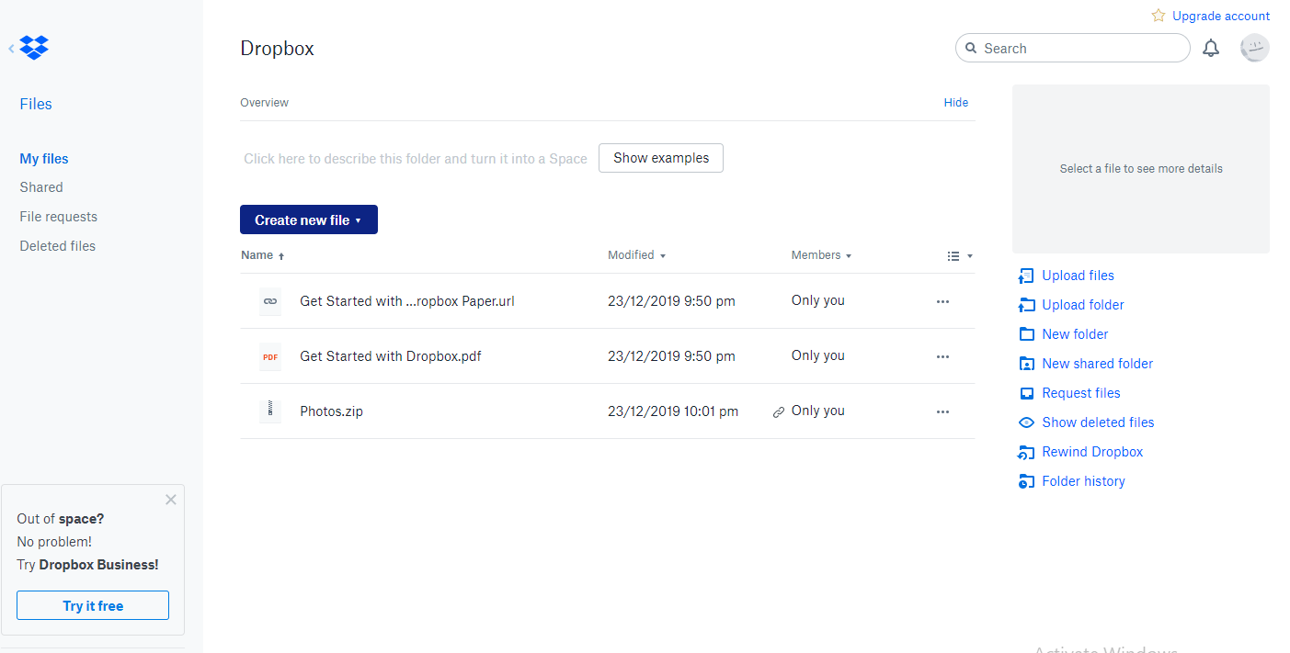
Drop box as IaaS: Where you rent storage space to save your photos.

Slide 43

Cloud Computing:
Benefits of Cloud Computing:
Cheaper option than buying the equipment outright. “Lower Capital Expenditure”
Easier to start up your business. “Lower Barrier to entry”
Immediate access to a broad range of application software.
Buy as little or many as you want and scale up or down as you need. “Real-time scalability”

Slide 44

Quantum Computing:
Quantum computing is the study of a non-classical model of computation.
Classical computer encodes data into bits, where each bit represents either a one or a zero.
Quantum computer encodes data into bits that can represent a one, a zero, or many more combination.

Slide 45
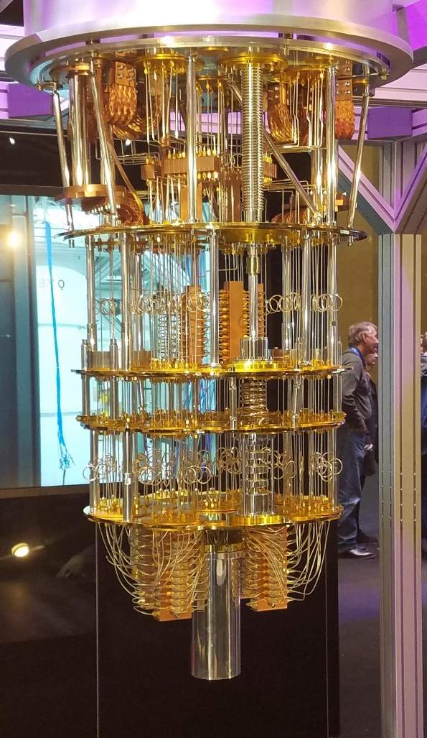
Quantum Computing:
What is the implication of this?
Class discussion.

Slide 46
End of Part 4
Activity 2.4. Define the following technologies:
Cloud computing.
Quantum Computing.

Slide 47
Innovation in IT
Part 5

Slide 48
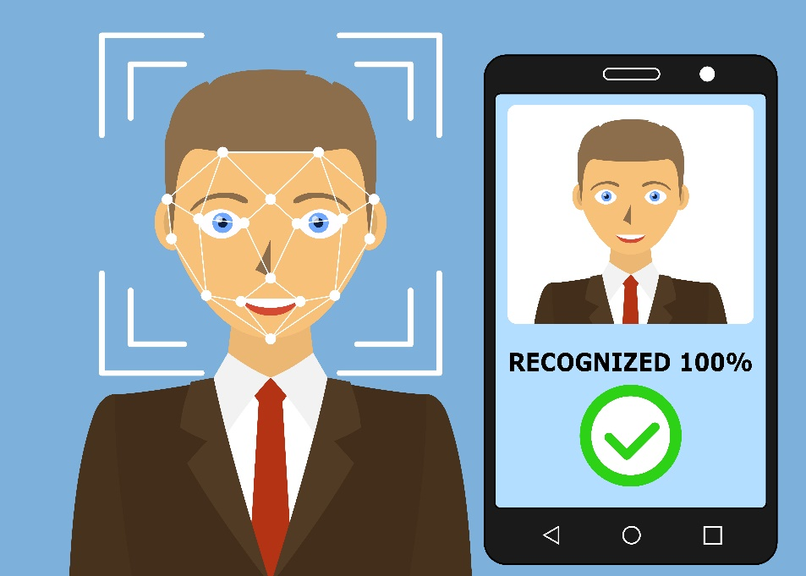
Facial Recognition
A facial recognition system is a technology capable of identifying or verifying a person from a digital image or a video frame from a video source.

Slide 49

Artificial Intelligence
What is Artificial intelligence (AI)?
the science of making machines imitate human thinking and behavior
Intelligent systems is a term that describes the various commercial applications of AI.
AI is concerned with:
studying the thought processes of humans
recreating those processes via machines, such as computer and robots.

Slide 50
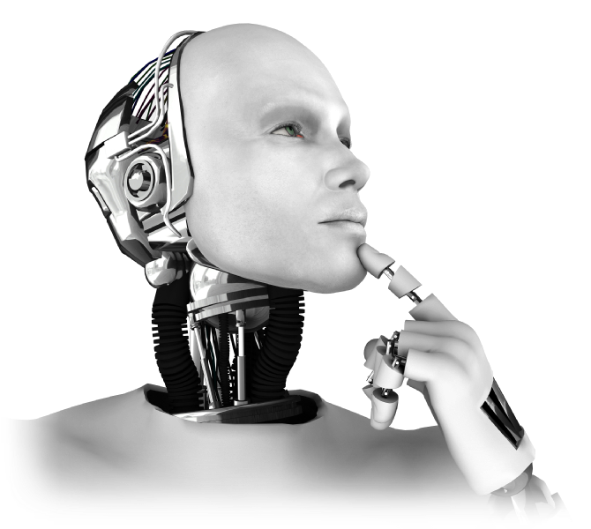
Artificial Intelligence
Robot – a mechanical device equipped with simulated human senses and the ability to take action on its own
Some scientist believe there will be time soon when robots will be given some human tasks.
Can you suggest what kind of tasks these can be?

Slide 51
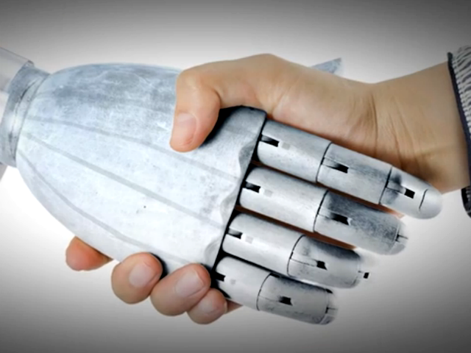
Artificial Intelligence
Types of AI systems used in business
Expert systems
Neural networks
Genetic algorithms
Intelligent agents
AI systems deliver the conclusion (rather than helping you analyze the options)

Slide 52
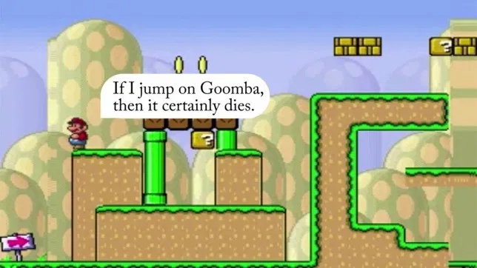
Super Mario A.I. Experiment
References below*
Notes:
https://www.huffingtonpost.co.uk/entry/artificial-intelligence-super-mario_n_6502664?ri18n=true
https://metro.co.uk/2015/01/21/german-students-make-mario-self-aware-learns-to-play-own-game-5030264/
https://mashable.com/2015/01/19/super-mario-artificial-intelligence/?europe=true

Slide 53
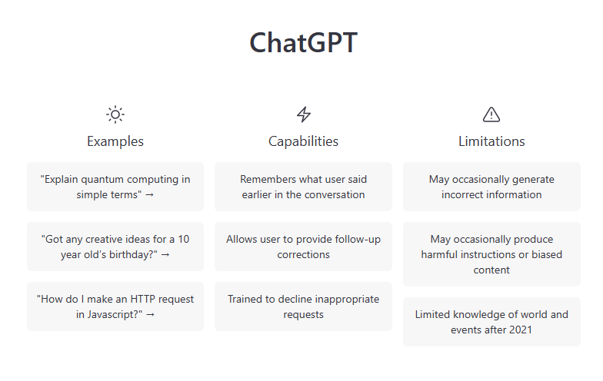
CHATGPT

Slide 54
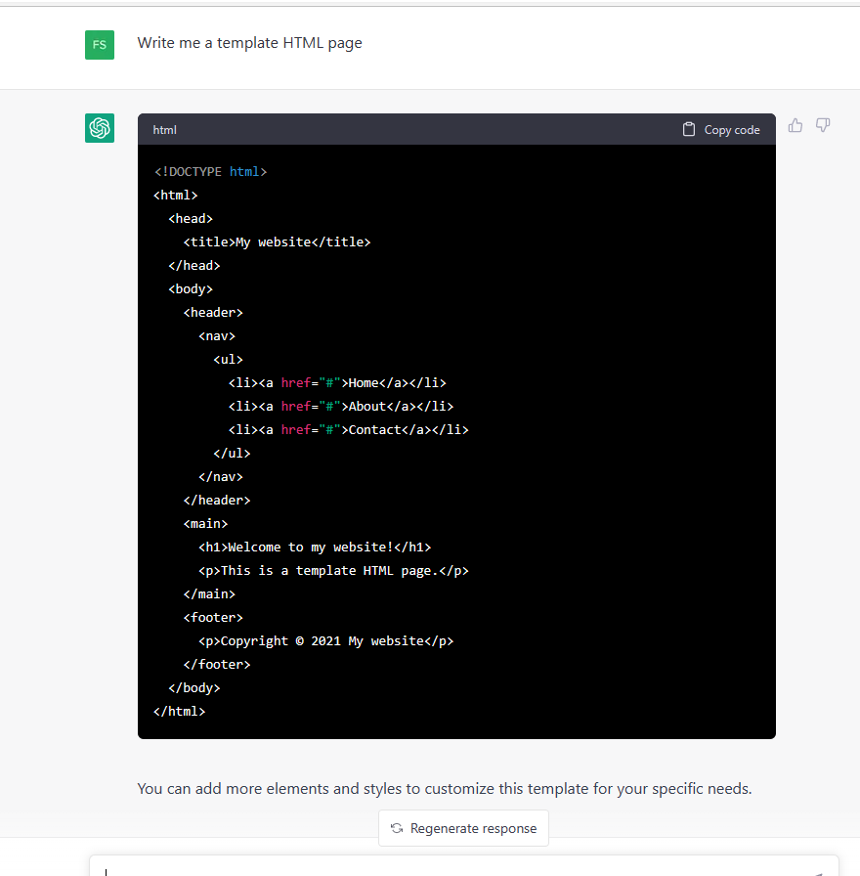
CHATGPT

Slide 55
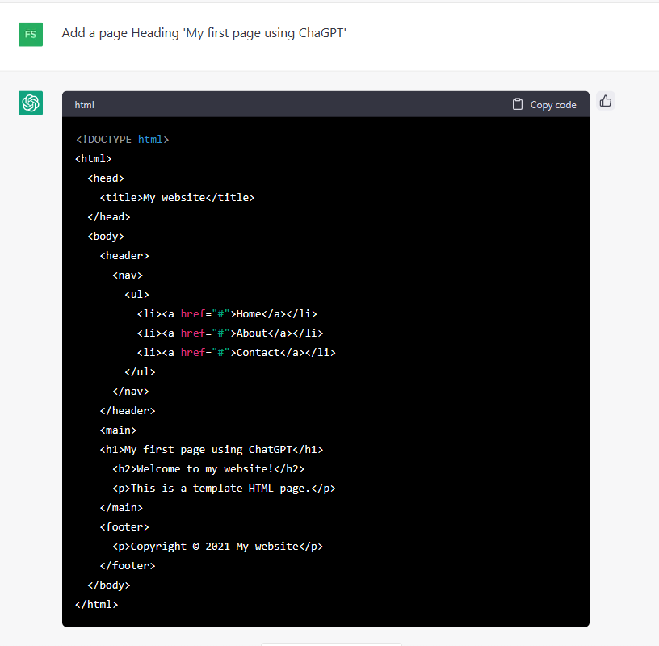
CHATGPT

Slide 56
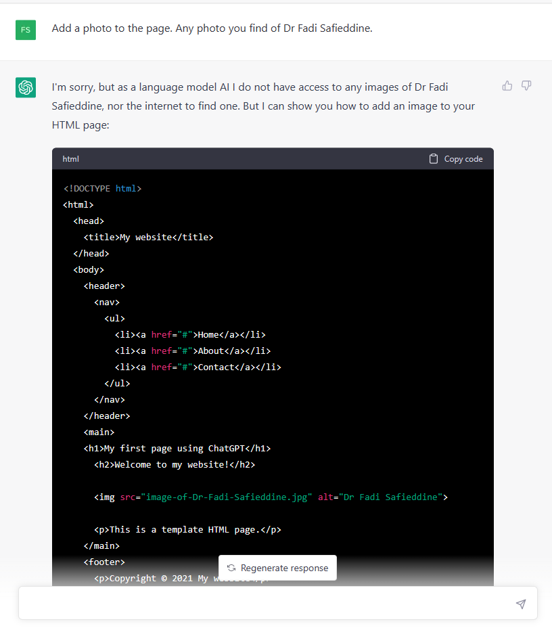
CHATGPT

Slide 57
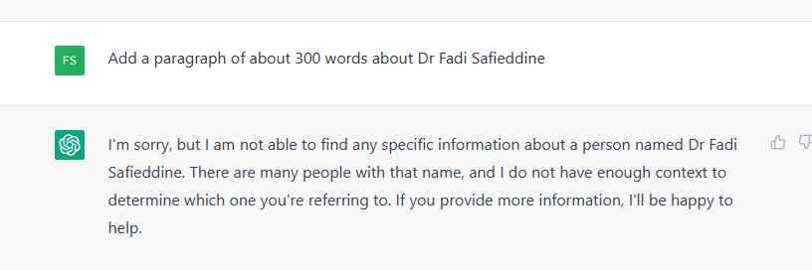
CHATGPT

Slide 58

CHATGPT

Slide 59

CHATGPT

Slide 60


CHATGPT

Slide 61

CHATGPT

Slide 62

CHATGPT

Slide 63

CHATGPT

Slide 64


CHATGPT

Slide 65
Lab Practice for this week
In week 2, please complete your tasks from week 1.
Deadline to submit is the end of the week.
Failure to submit will mean you will not get formative feedback!

Slide 66
End of Part 5
Activity 2.5. Reflect:
Combining A.I with Quantum computing, with Robotics, how far are we from having real humanoid robots?

